Slide 1
Chapter 10: File System Implementation

Slide 2
Chapter 10: File System Implementation
File-System Structure
File-System Implementation
Directory Implementation
Allocation Methods
Performance

Slide 3
File-System Structure
File structure- Disks provide the bulk of secondary storage on which a file system is Maintained. They have two characteristics that make them a convenient medium for storing multiple files
  Logical storage unit
  Collection of related information (accesses sequentially or randomly)
File system resides on secondary storage (disks)
  Provided user interface to storage, mapping logical to physical
  Provides efficient and convenient access to disk by allowing data to be stored, located retrieved easily
Disk provides in-place rewrite and random access
  I/O transfers performed in blocks of sectors (usually 512 bytes)
File control block – storage structure consisting of information about a file
Device driver controls the physical device
File system organized into layers

Slide 4

Layered File System

Slide 5
Layered File System
I/O Control level –
Device drivers acts as interface between devices and Os, they help to transfer data between disk and main memory. It takes block number as input and as output it gives low level hardware specific instruction.
Basic file system –
It Issues general commands to device driver to read and write physical blocks on disk. It manages the memory buffers and caches. A block in buffer can hold the contents of the disk block and cache stores frequently used file system metadata.
File organization Module –
It has information about files, location of files and their logical and physical blocks . Physical blocks do not match with logical numbers of logical block numbered from 0 to N. It also has a free space which tracks unallocated blocks.

Slide 6
Layered File System
Logical file system –
It manages metadata information about a file i.e includes all details about a file except the actual contents of file. It also maintains via file control blocks. File control block (FCB) has information about a file – owner, size, permissions, location of file contents.

Slide 7
We can implement file system by using two types data structures :
On-disk Structures –
In-Memory Structure :

Slide 8
On-disk Structures
Generally, they contain information about total number of disk blocks, free disk blocks, location of them and etc. Below given are different on-disk structures :
Boot Control Block –
It is usually the first block of volume, and it contains information needed to boot an operating system. In UNIX it is called boot block and in NTFS it is called as partition boot sector.
Volume Control Block –
It has information about a particular partition :- free block count, block size and block pointers etc. In UNIX it is called super block and in NTFS it is stored in master file table.
Directory Structure –
They store file names and associated inode numbers. In UNIX, includes file names and associated file names and in NTFS, it is stored in master file table.
Per-File FCB –
It contains details about files, and it has a unique identifier number to allow association with directory entry. In NTFS it is stored in master file table.

Slide 9
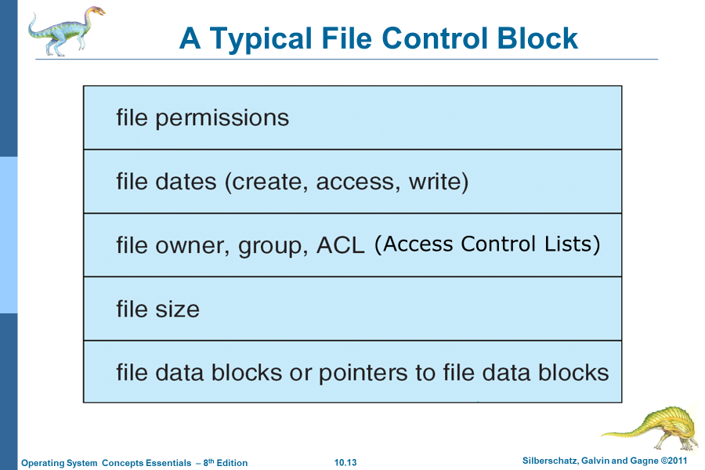


Slide 10
In-Memory Structure :
. They are maintained in main-memory and these are helpful for file system management for caching. Several in-memory structures given below :
Mount Table –
It contains information about each mounted volume.
Directory-Structure cache –
This cache holds the directory information of recently accessed directories.
System wide open-file table –
It contains the copy of FCB of each open file.
Per-process open-file table –
It contains information opened by that particular process and it maps with appropriate system wide open-file

Slide 11
Mounting and Unmounting File Systems
Before you can access the files on a file system, you need to mount the file system. Mounting a file system attaches that file system to a directory (mount point) and makes it available to the system. The root (/) file system is always mounted. Any other file system can be connected or disconnected from the root (/) file system.
When you mount a file system, any files or directories in the underlying mount point directory are unavailable as long as the file system is mounted. These files are not permanently affected by the mounting process, and they become available again when the file system is unmounted.

Slide 12
Directory Implementation
The selection of directory-allocation and directory-management algorithms significantly affects the efficiency, performance, and reliability of the file system.
Linear list of file names with pointer to the data blocks
  Simple to program
  Time-consuming to execute
    Linear search time
    Could keep ordered alphabetically via linked list or use B+ tree
Hash Table – linear list with hash data structure
  Decreases directory search time
  Collisions – situations where two file names hash to the same location
  Only good if entries are fixed size, or use chained-overflow method

Slide 13
Allocation Methods
The direct-access nature of disks allows us flexibility in the implementation of files.
In almost every case, many files are stored on the same disk.
The main problem is how to allocate space to these files so that disk space is utilized effectively, and files can be accessed quickly.
Three major methods of allocating disk space are in wide use:
  Contiguous
  Linked
  indexed

Slide 14
Allocation Methods - Contiguous
Contiguous allocation – In this scheme, each file occupies a contiguous set of blocks on the disk. For example, if a file requires n blocks and is given a block b as the starting location, then the blocks assigned to the file will be b, b+1, b+2,……b+n-1. This means that given the starting block address and the length of the file (in terms of blocks required), we can determine the blocks occupied by the file.
The directory entry for a file with contiguous allocation contains
Address of starting block
Length of the allocated portion.

Slide 15

Contiguous Allocation of Disk Space

Slide 16
Contiguous
Advantages:
Both the Sequential and Direct Accesses are supported by this. For direct access, the address of the kth block of the file which starts at block b can easily be obtained as (b+k).
This is extremely fast since the number of seeks are minimal because of contiguous allocation of file blocks.
Disadvantages:
This method suffers from both internal and external fragmentation. This makes it inefficient in terms of memory utilization.
Increasing file size is difficult because it depends on the availability of contiguous memory at a particular instance.

Slide 17
Extent-Based Systems
To minimize these drawbacks, some operating systems use a modified contiguous-allocation scheme. Here, a contiguous chunk of space is allocated initially; then, if that amount proves not to be large enough, another chunk of contiguous space, known as an extent, is added. The location of a file’s blocks is then recorded as a location and a block count, plus a link to the first block of the next extent.
Extent-based file systems allocate disk blocks in extents
An extent is a contiguous block of disks
  Extents are allocated for file allocation
  A file consists of one or more extents

Slide 18
Allocation Methods - Linked
Linked allocation –
In this scheme, each file is a linked list of disk blocks which need not be contiguous. The disk blocks can be scattered anywhere on the disk.
The directory entry contains a pointer to the starting and the ending file block. Each block contains a pointer to the next block occupied by the file.
The file ‘jeep’ in following image shows how the blocks are randomly distributed. The last block (25) contains -1 indicating a null pointer and does not point to any other block.

Slide 19
Linked Allocation
Each file is a linked list of disk blocks: blocks may be scattered anywhere on the disk
block =
pointer

Slide 20

Linked Allocation

Slide 21
Linked Allocation
Advantages:
This is very flexible in terms of file size. File size can be increased easily since the system does not have to look for a contiguous chunk of memory.
This method does not suffer from external fragmentation. This makes it relatively better in terms of memory utilization.
Disadvantages:
Because the file blocks are distributed randomly on the disk, a large number of seeks are needed to access every block individually. This makes linked allocation slower.
It does not support random or direct access. We can not directly access the blocks of a file. A block k of a file can be accessed by traversing k blocks sequentially (sequential access ) from the starting block of the file via block pointers.
Pointers required in the linked allocation incur some extra overhead.

Slide 22
Allocation Methods - Indexed
In this scheme, a special block known as the Index block contains the pointers to all the blocks occupied by a file. Each file has its own index block. The i^{th} entry in the index block contains the disk address of the i^{th} file block. The directory entry contains the address of the index block as shown in the image:

Slide 23
Allocation Methods - Indexed
Indexed allocation
  Each file has its own index block(s) of pointers to its data blocks
Logical view
index table

Slide 24

Example of Indexed Allocation

Slide 25
Indexed Allocation (Cont.)
Need index table
Random access
Dynamic access without external fragmentation, but have overhead of index block
Advantages:
This supports direct access to the blocks occupied by the file and therefore provides fast access to the file blocks.
It overcomes the problem of external fragmentation.
Disadvantages:
The pointer overhead for indexed allocation is greater than linked allocation.
For very small files, say files that expand only 2-3 blocks, the indexed allocation would keep one entire block (index block) for the pointers which is inefficient in terms of memory utilization. However, in linked allocation we lose the space of only 1 pointer per block.

Slide 26
Indexed Allocation – Mapping (Cont.)

outer-index
index table
file

Slide 27
Performance
Best method depends on file access type
  Contiguous great for sequential and random
Linked good for sequential, not random
Declare access type at creation -> select either contiguous or linked
Indexed more complex
  Single block access could require 2 index block reads then data block read
  Clustering can help improve throughput, reduce CPU overhead

